Slide 1
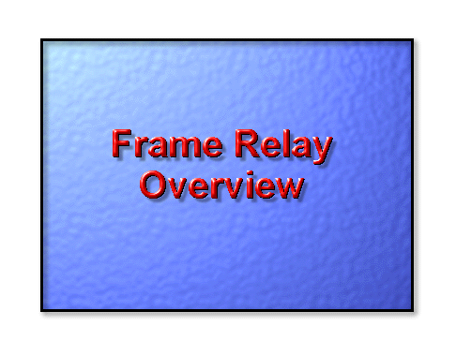

Slide 2
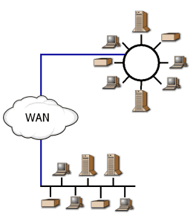
Frame Relay is a WAN protocol that operates at the first two levels of the OSI model. Though it was initially designed for ISDN, it can be implemented over various network interfaces . It is a high-speed communications technology that is used in hundreds of networks throughout the world to connect LAN, SNA, Internet and even voice applications.
Frame relay is a way of sending information over a wide area network (WAN) that divides the information into frames or packets. Each frame has an address that the network uses to determine the destination of the frame. The frames travel through a series of switches within the frame relay network via virtual circuits and arrive at their destination.

Slide 3
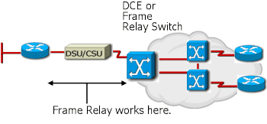
Characteristics of Frame Relay
Frame Relay provides a means for statistically multiplexing many logical data conversations (referred to as virtual circuits) over a single physical transmission link by assigning connection identifiers to each pair of data terminal equipment (DTE).
It relies on upper-layer protocols for error correction and today's more dependable fiber and digital networks.
It is a connection-oriented data-link technology that is streamlined to provide high performance and efficiency.

Slide 4
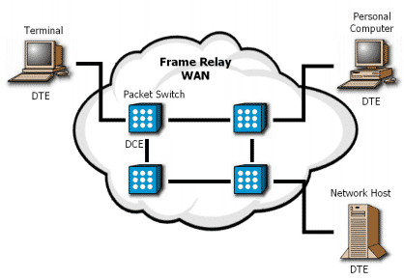
Frame Relay Devices
A frame relay network consists of endpoints (e.g., PCs, servers, host computers), frame relay access equipment (e.g., bridges, routers, hosts, frame relay access devices) and network devices (e.g., switches, network routers, T1/E1multiplexers). These devices fall into two different categories:
DTE: Data Terminating Equipment
DCE: Data Communication Equipment
DTE
DTEs are privately owned node and internetworking devices. These devices include the endpoints and access equipment to a Frame Relay network. DTEs initiate communication exchanges.
DCE
DCEs are the carrier controlled internetworking devices. These devices also include access equipment but center around the network devices. DCEs respond to the exchanges initiated by the DTEs.

Slide 5
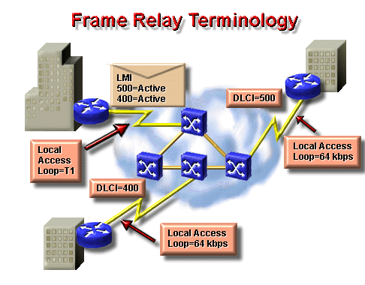
Following are some terms that are used frequently when discussing Frame Relay:
Local access rate—The clock speed (port speed) of the connection (local loop) to the Frame Relay cloud. It is the rate at which data travels into or out of the network.
Data-link connection identifier (DLCI)—A number that identifies the logical circuit
between the source and destination device. The FR switch maps the DLCIs between each pair of routers to create a PVC.
Local Management Interface (LMI)—A signaling standard between the CPE device and the FR switch that is responsible for managing the connection and maintaining status between the devices.
Committed information rate (CIR)—The rate, in bits per second, that the Frame Relay switch agrees to transfer data.
Committed Burst (Bc)—The maximum number of bits that the switch agrees to transfer during any Committed Rate Measurement Interval (Tc).

Slide 6
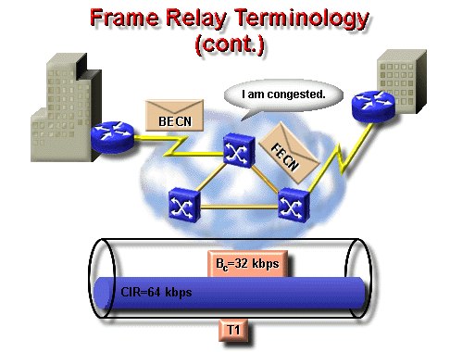
Forward explicit congestion notification (FECN)—When a Frame Relay switch recognizes congestion in the network, it sends an FECN packet to the destination device indicating that congestion has occurred.
Backward explicit congestion notification (BECN)—When a Frame Relay switch recognizes congestion in the network, it sends a BECN packet to the source router instructing the router to reduce the rate at which it is sending packets.
Discard Eligibility (DE) Indicator—When the router detects network congestion, the FR switch will drop packets with the DE bit set first. The DE bit is set on the oversubscribed traffic; that is, the traffic that was received after the CIR was met.

Slide 7
Frame Relay Virtual Circuits
A frame relay network will often be depicted as a network cloud, because the frame relay network is not a single physical connection between one endpoint and the other. Instead, a logical path is defined within the network. This path is based on the concept of using virtual circuits (VCs). VCs are two-way, software-defined data paths between two ports that act as private line replacements in the network.There are two types of virtual circuits:
Switched Virtual Circuits
Permanent Virtual Circuits
Switched Virtual Circuits
Switched Virtual Circuits, or SVCs, are temporary connections that are used when there is only intermittent data transfer between DTE devices across the Frame Relay network. There are four states of an SVC:
Call setup
Data transfer
Idling
Call termination

Slide 8
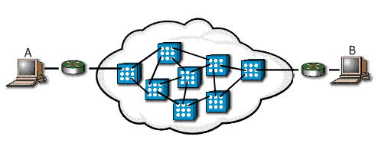
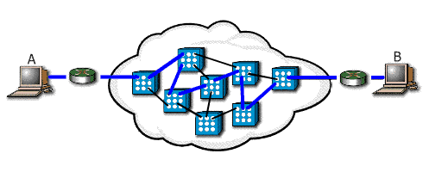

Slide Show Images | Text
 | Call Setup: In this initial state, the virtual circuit between two Frame Relay DTE devices is established.
 | Data Transfer: Next, data is transmitted between the DTE devices over the virtual circuit.
Idling: In the idling stage, the connection is still open, but the data transfer has ceased.

Slide 9

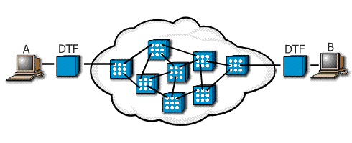
 | Call Termination: After the connection has idled for a particular period of time, the connection between the two DTEs is terminated
Permanent Virtual Circuits
PVCs are fixed paths and, therefore, are not created on demand or on a "call-by-call" basis. Although the actual path taken through the network may vary from time to time, such as when automatic rerouting takes place, the beginning and end of the circuit will not change. In this way, the PVC is like a dedicated point-to-point circuit.

Slide 10
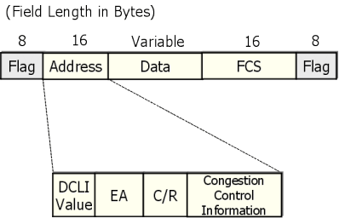
Frame Relay Frame Structure
In a frame relay frame, user data packets are not changed in any way. Frame relay simply adds a two-byte header to the packets. The packets within a frame may come from any number of sources and do not affect the frame in any way. A typical frame structured follows:
Flags - specify the beginning and end of a frame
Address - contains the DCLI value (data link connection identifier), Extended Address, C/R, and Congestion control information
  DLCI Value - indicates the data link connection identifier value. Consists of the first 10 bits of the Address field.
  EA - Indicates the length of the Address field. Currently 2 bytes
  C/R - Bit that follows the most significant DLCI byte in the Address field. The C/R bit is not currently defined.
  Congestion Control - The three bits that control the Frame Relay congestion notification mechanisms.
  Data - contains the encapsulated data from the upper layers of the device. This field is a variable length.
  FCS - (Frame Check Sequence) contains information to ensure the completeness of the frame.

Slide 11
Step | Action | Results and Notes
1. | Select the interface needed for Frame Relay using the interface configuration mode. Router(config-int)#interface serial1 | Once the interface configuration is entered, the CLI prompt will change from (config)# to (config-if)#
2. | Configure a network-layer address, for example, an IP address. router(config-if)#ip address 10.16.0.1 255.255.255.0 | A network address may not need to be configured. This could have occured earlier in router configuration.
3. | Select the Frame Relay encapsulation type used to encapsulate data traffic end-to-end using the encapsulation frame-relay interface configuration command. router(config-if)#encapsulation frame-relay cisco | cisco - Use this if connecting to another Cisco router. This is the default. ietf - Select this if connecting to a non-Cisco router.
4. | Establish LMI connection using the frame-relay lmi-type interface configuration command. router(config-if)#frame-relay lmi-type cisco | This command is only needed if using Cisco IOS Release 11.1 or earlier. With IOS Release 11.2 or later, the LMI-type is autosensed, so no configuration is needed. cisco is the default.
5.
6.

Slide 12
Configure the bandwidth for the link using the bandwidth kilobits interface configuration command. router(config-if)#bandwidth 64 | This command affects routing operation by protocols such as IGRP.
Reenable Inverse ARP if it was disabled on the router using the frame-relay inverse-arp [protocol ] [dlci] interface configuration command. router(config-if)#frame-relay inverse-arp ip 16 | protocol - Supported protocols include ip, ipx, appletalk, decnet, vines, and xns. dlci - The DLCI on the local interface that you want to exchange Inverse ARP messages. Inverse ARP is on by default.

Slide 13
show interface | Displays information regarding the encapsulation, and Layer 1 and Layer 2 status. It also displays information about the DLCIs used on the Frame Relay configured serial interface, and the LMI DLCI used for the local management interface. View example results
show frame-relay lmi | Displays LMI traffic statistics, such as LMI type, status inquiry messages sent, status messages recieved, and invalid LMI messages. View example results
show frame-relay pvc | Displays the status of all configured connection as well as traffic statistics. This command is also useful for viewing the number of backward explicit congestion notification (BECN) and forward explicit congestion notification (FECN) packets received by the router. The PVC STATUS can be active, inactive, or deleted. View example results
show frame-relay map | Displays the current map entries and information about the connections for static and dynamic routes. View example results To clear dynamically created Frame Relay maps, which are created by the use of Inverse ARP, use the clear frame-relay-inarp privileged EXEC command.

Slide 14
NAT (Network Address Translation)

Slide 15
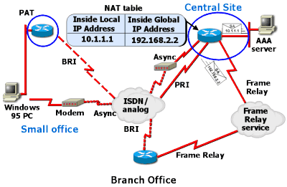
Outline

Slide 16
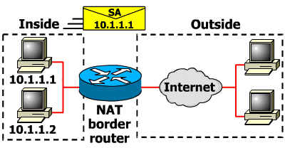
Network Address Translation
IP address depletion is a key problem facing the public network. To maximize the use of your registered IP addresses, Cisco IOS™ Release 11.2 software and subsequent releases implement NAT. This feature, which is Cisco's implementation of RFC 1631, The IP Network Address Translator, is a solution that provides a way to use the same IP addresses in multiple internal subnetworks, thereby reducing the need for registered IP addresses.

Slide 17
Types of NAT Translations?
The translation performed using NAT can be either static or dynamic and are also used in load sharing.
Static Translation
Static translation occurs when you specifically configure addresses in a lookup table. A specific inside address maps into a prespecified outside address. The inside and outside addresses are statically mapped one-for-one.
Dynamic Translations
Dynamic mapping occurs when the NAT border router is configured to understand which inside addresses must be translated, and which pool of addresses may be used for the outside addresses. There can be multiple pools of outside addresses. Multiple internal hosts can also share a single outside IP address, which conserves address space. Address sharing is accomplished by port multiplexing, or changing the source port on the outbound packet so that replies can be directed back to the appropriate router.
Load Sharing
For load sharing, you can map outside IP addresses to inside IP addresses using the Transmission Control Protocol (TCP) load distribution feature. Load distribution can also be accomplished using NAT where one external address maps to this address.

Slide 18
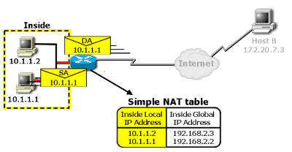
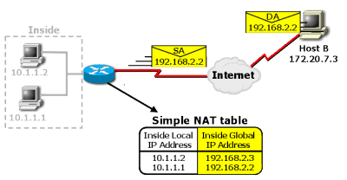
components
Slide Show Images | Text
 | Inside local IP address -The IP address assigned to a host on the inside network. The address was globally unique but obsolete, allocated from RFC 1918, Address Allocation for Private Internet Space, or randomly picked.
 | Inside global IP address -A legitimate IP address (assigned by the NIC or service provider) that represents one or more inside local IP addresses to the outside world. The address was allocated from a globally unique address space, typically provided by the Internet Service Provider (ISP).

Slide 19
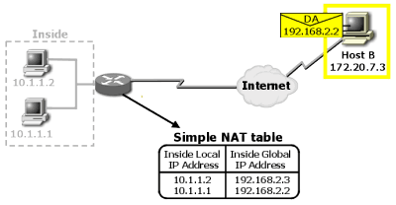
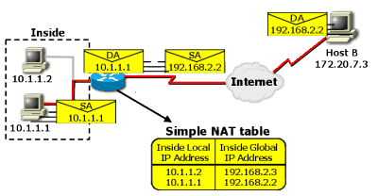
Slide Show Images | Text
 | Outside global IP address -The IP address that was assigned to a host on the outside network by its owner. The address was allocated from a globally routable address space.
 | Simple translation -A translation entry that maps one IP address to another.

